Slide 1



MANUFACTURING
PROJECT
Presented by: Group 2
OUR TEAM
Sandhiya K
Nikita Sankapal
Kappala HimaSindhu
Pratik Bhure
Bobita Samantray
Pradeep S
Banoth Naik

Slide 2

OVERVIEW
01
02
Problem statement
KPI Overview
03
04
Dashboard Overview
Conclusion

Slide 3

Analyzing Manufacturing Data
Problem Statement
“Identifying Assess quality issues to analyzing rejected quantities and wastage percentages for different items with the highest rejection or wastage rates."

Slide 4

KPI OVERVIEW
KPI 1
Employee-Wise Rejected Quantity
Machine wise Rejected Quantities
KPI 2
KPI 3
Production comparison trend
Manufacturing vs Rejected Quantities
KPI 4
KPI 5
Department-Wise Manufactured vs. Rejected Quantities
KPI 6

Slide 5


KPI 1: EMPLOYEE-WISE REJECTED QUANTITY
Insight:
Shruti Singh has an exceptionally high rejection quantity (520,867) compare to other, indicating a data issue or process anomaly.
Improve Area :
Investigate Shruti Singh’s data for potential errors or quality issues. Standardize data entry for better reliability.

Slide 6
KPI 2: MACHINE WISE REJECTED QTY
Insights:
High Contribution of N/A: The N/A Machine category alone accounts for 99.38% of total rejections (521,507 out of 524,729).
Machine-wise Analysis for ex. MC094: Moderate rejection at 500 items (0.095% of total). Indicates potential areas of inefficiency
Improve Area :
Resolve N/A (Not Applicable) Category
Focus on Machines with High Rejections
Zero-Rejection Machines (MC026, MC064).

Slide 7
KPI 3: PRODUCTION COMPARISON TREND
Insights:
Rejection rates vary across dates(Highest=10 Nov, Lowest=9 Nov).
Dates with higher production quantities generally correspond to higher rejections. This could indicate quantity control challenges during peak production
Improve Area :
Identify days with unusually high rates and investigate reasons such as material quality, machine performance, or workforce errors.
Calculate the daily rejection rate for improvement

Slide 8
KPI 4: MANUFACTURING VS REJECTED QTY
Insights:
A rejection rate of 0.60% indicates a reasonable quality control level but suggests potential improvement areas, especially on high-rejection days.
While 0.60% may seem minimal, the absolute rejected quantity (524,729) can represent significant material loss and cost, especially in large-scale manufacturing.
Improve Area:
Focus on high-rejection days or machines to reduce losses further.
Track daily rejection rates and compare them with the overall rate (0.60) to identify and address specific inefficiencies.

Slide 9
KPI 5: DEPARTMENT WISE REJECTED QTY AND MANUFACTURING QTY
Insights:
Significant Contribution from Woven Labels: 99.38% of total rejections (521,508 out of 524,729). This indicates a major quality issue specific to the woven label manufacturing process.
Printed Labels have an extremely low rejection rate (0.011%), reflecting excellent quality control and efficient production processes.
Improve Area :
Woven label process optimization-Analyze key issue ,Improvement quality check
Set rejection rate benchmark for woven label (eg,<0.50%) and gradually work towards achieving it.
Enhance intermediate and final inspection processes for woven labels to catch defects earlier.

Slide 10

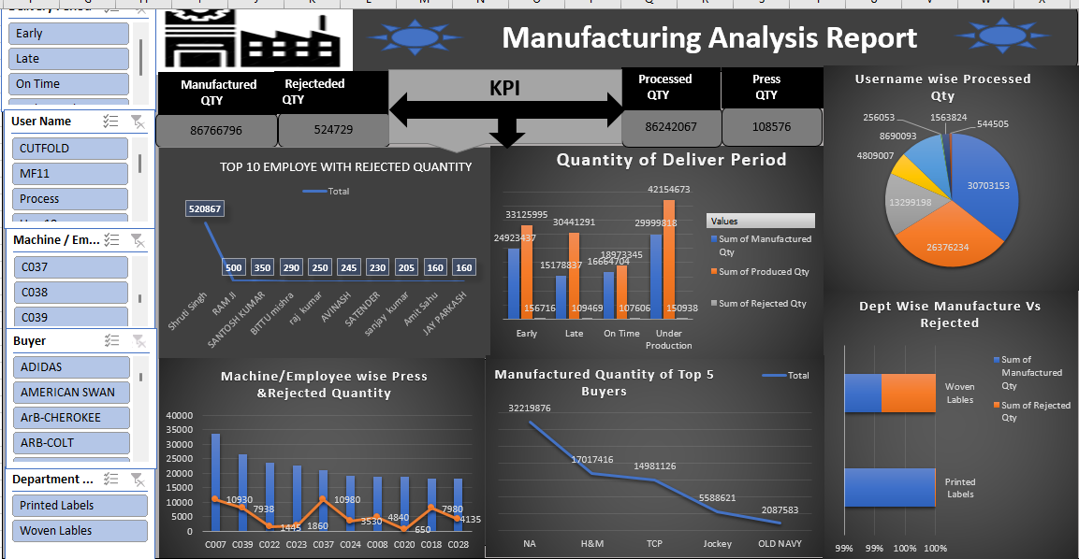
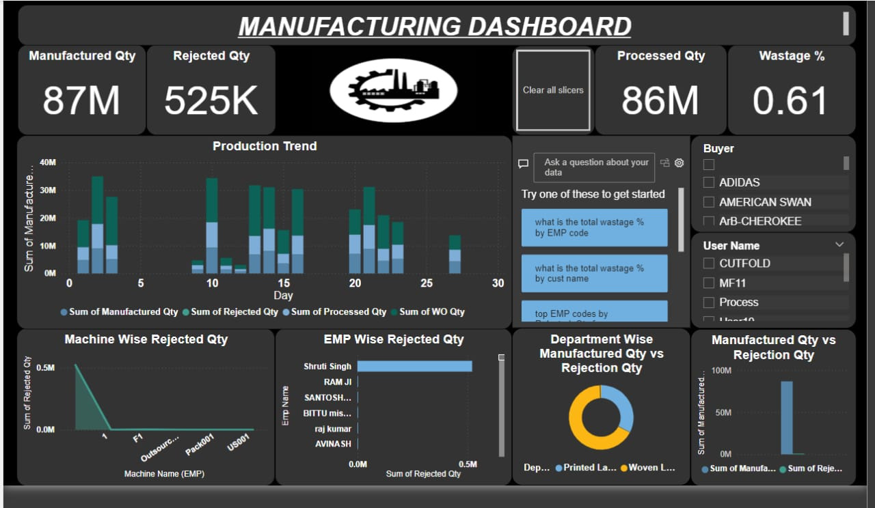
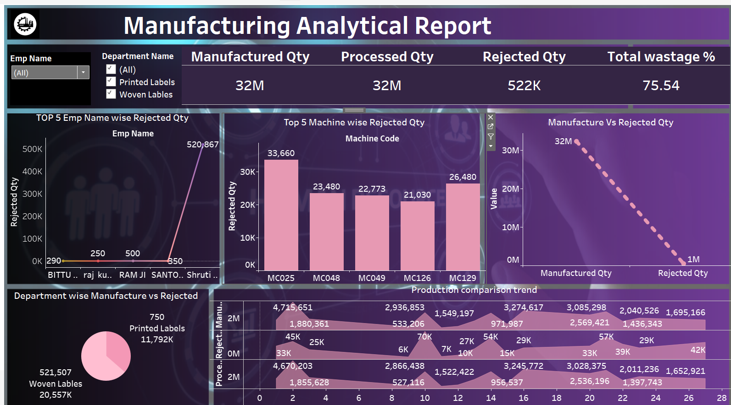
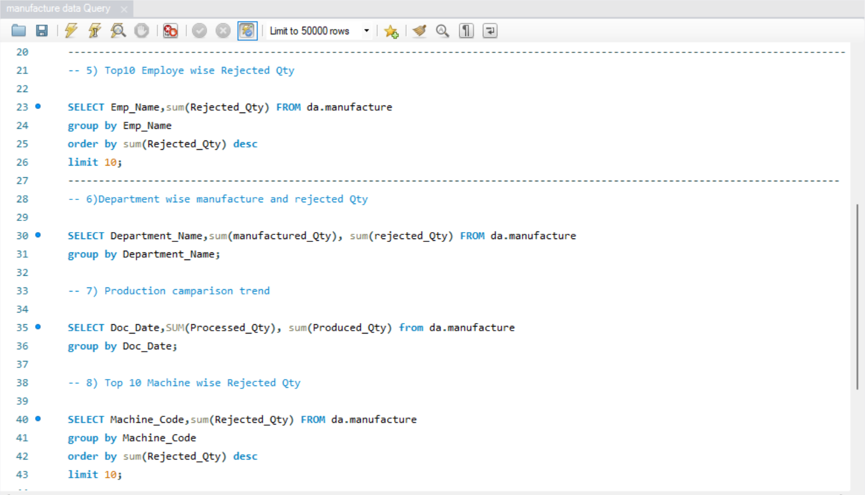

DASHBOARD OVERVIEW

Slide 11





KEY TAKEAWAYS & NEXT STEPS
Focus Areas
Prioritize investigation of high-rejection areas and optimize processes for consistent quality.
01
Data Standardization
Standardize data entry for consistent labeling and formatting for accurate analysis.
02
Continuous Monitoring
Regularly analyze data to identify trends, optimize processes, and maintain high-quality production.
03

Slide 12
THANK YOU

